Slide 1

Emily’s second toolbox of
The Ising model

Slide 2


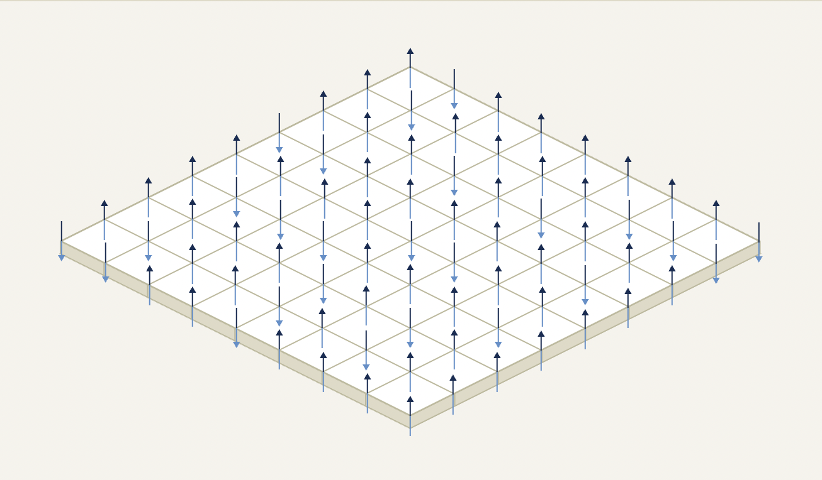


This is a description of ferromagnetism that tries to model the interactions of a spin lattice
What
is it!

Slide 3


This will be fun
https://physics.weber.edu/schroeder/software/demos/isingmodel.html

Slide 4



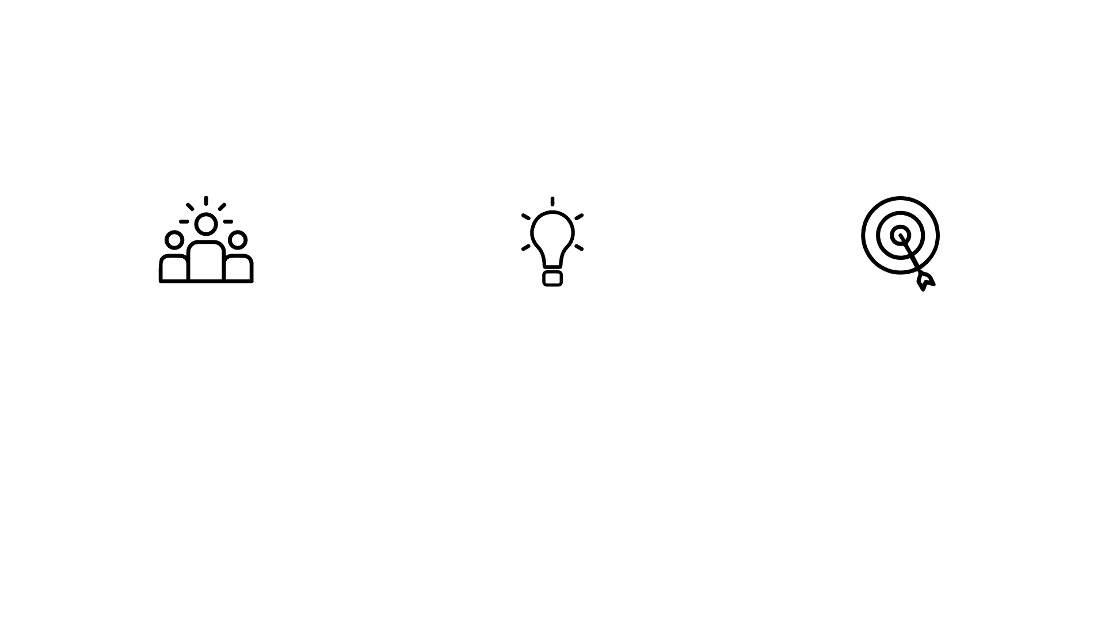
Why you should care
Phase-transitions
Population Statistics
Six degrees of separation
Can study when exactly the critical temperature or field should flip spins
Can be used to model segregation
Resolves the ‘small world’ phenomena where everything is connected

Slide 5
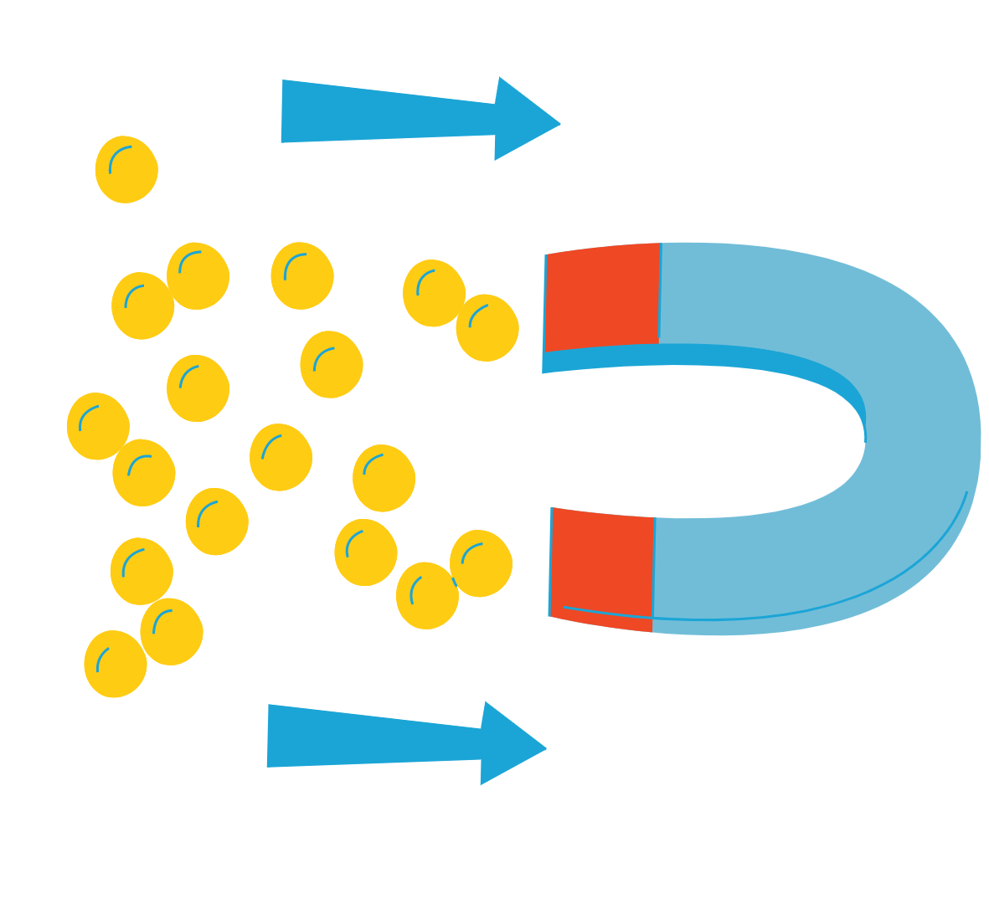
Metropolis-Hastings algorithm
Why I brought this up in this comp class

Slide 6
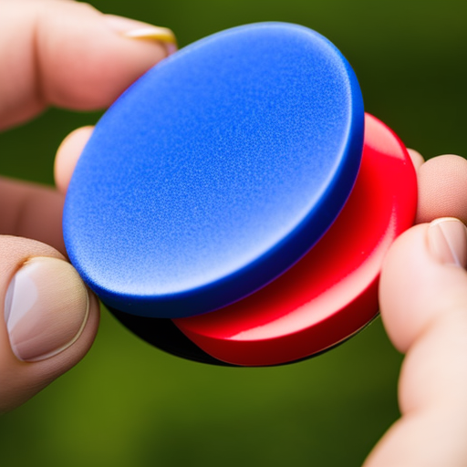

Metropolis-Hastings Algo
Initialize
Pick some x0 and t=0
Iterate.
Generate a random candidate
Calculate acceptance.
Accept/reject and increment

Slide 7


This is useful because
How do we know which way the magnets will align their spin as we change conditions! | By using this probability method, we can guess how the spins will end up aligning in the Ising model and use this to predict phase transitions

Slide 8



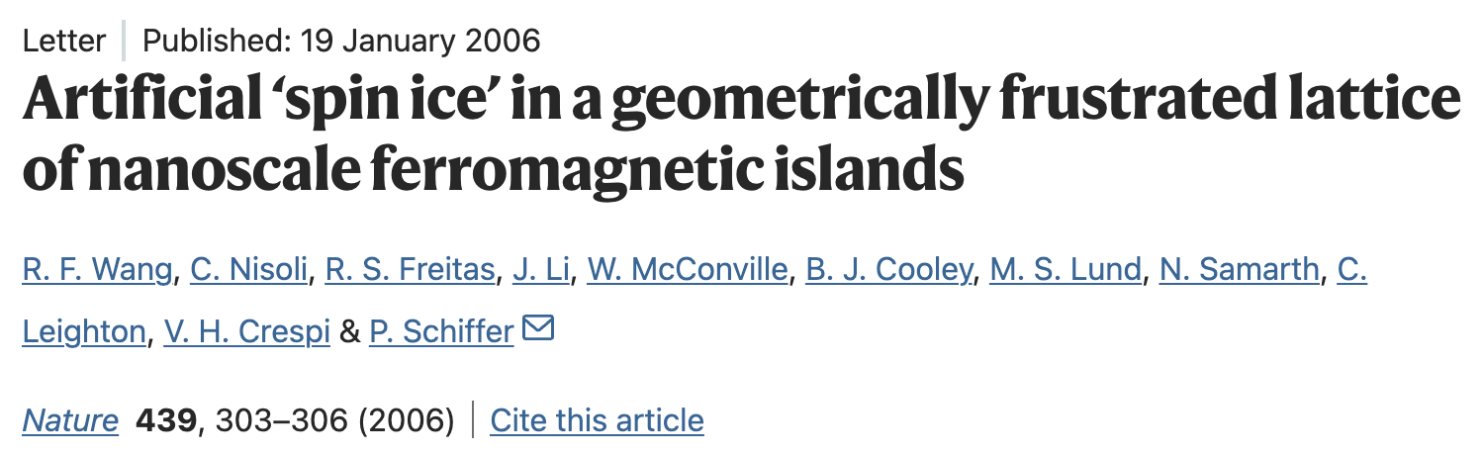
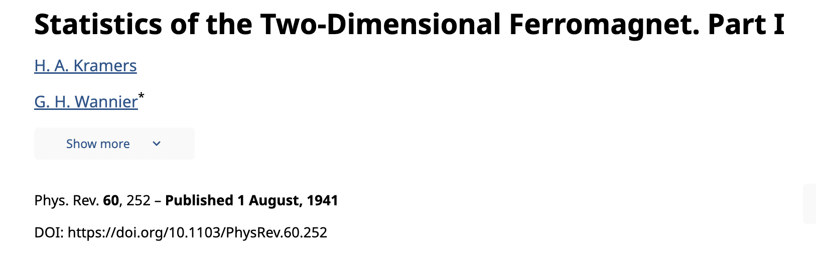
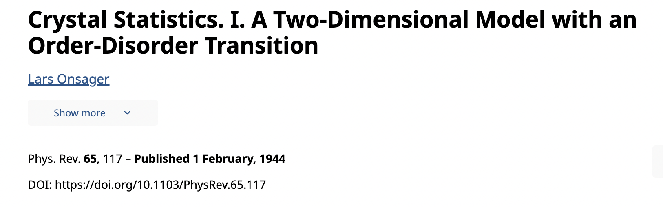
Interesting literature

